Slide 1

C2 HEALTH APP

Slide 2
OVERVIEW
01
04
PROBLEM STATEMMENT
TECHNOLOGY STACK
02
SOLUTION
05
TEAM MEMBERS
03
HOW IT WORKS

Slide 3

INTRODUCTION
Our problem statement is-
Rapid urbanization brings about unique health challenges, inadequate healthcare access, lifestyle-related diseases, and the overall impact of the urban environment on the physical and mental well-being of residents. Despite the growing awareness of these issues, there is a lack of a comprehensive and user-friendly tool that enables individuals to assess and understand about their health.

Slide 4
SOLUTION
We have built an app that enables user to know about any airborne or waterborne disease by symptoms.
Apart from predicting disease, our app is also giving the medication ,precautions, diet to be taken for the predicted disease.

Slide 5
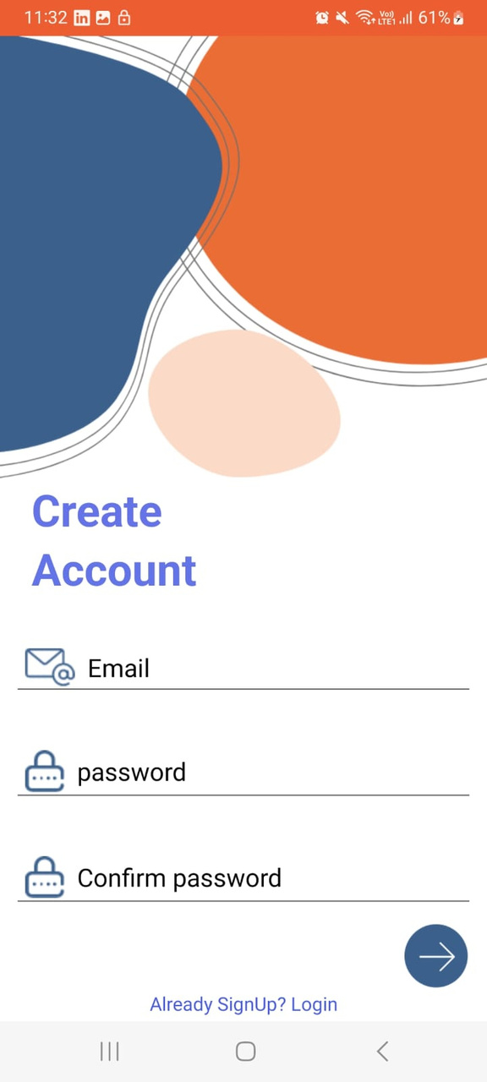
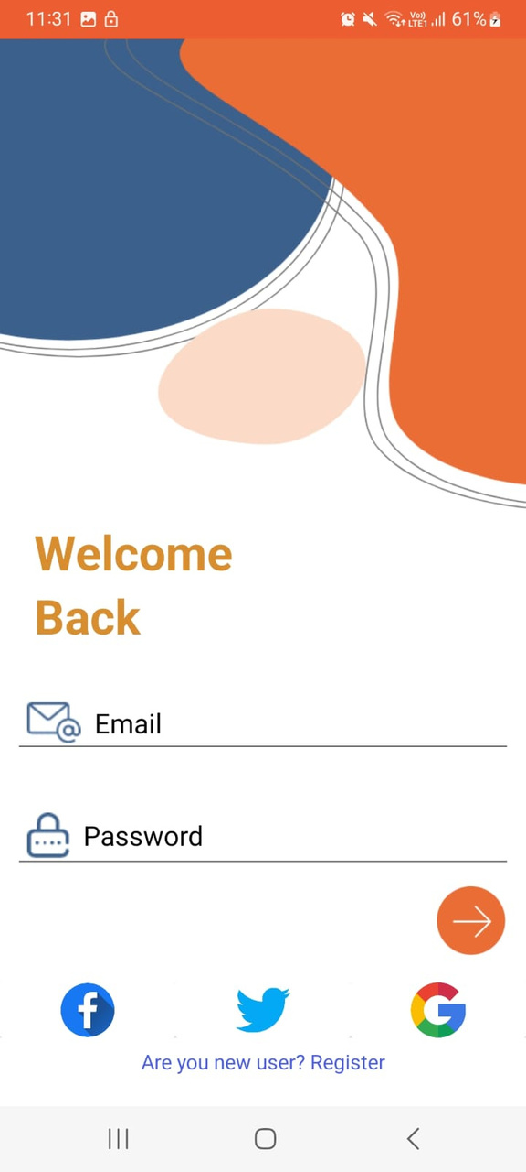
WORKING

Slide 6
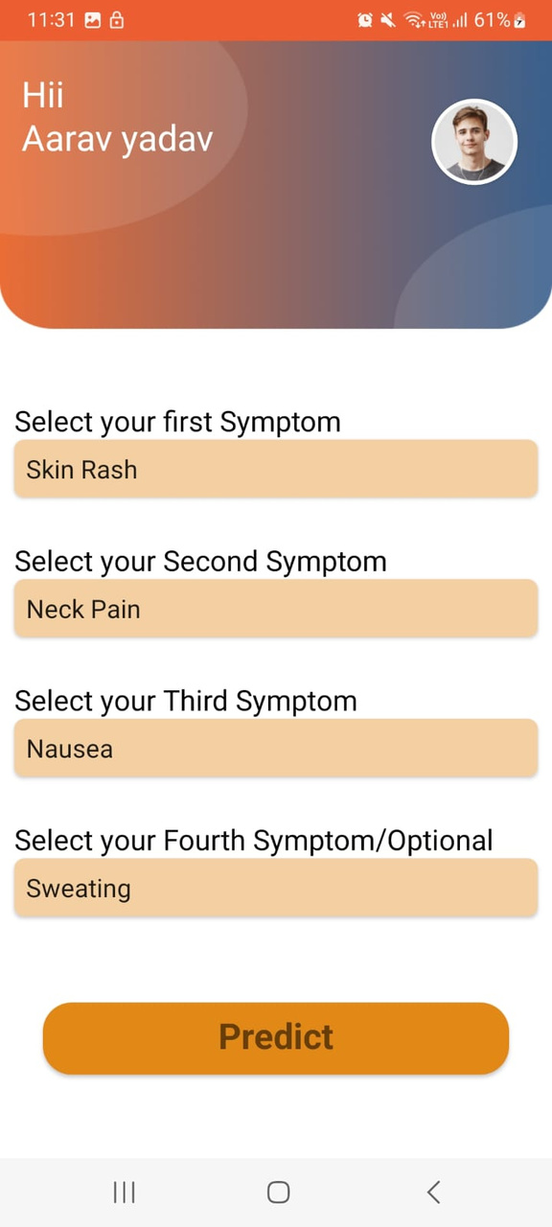
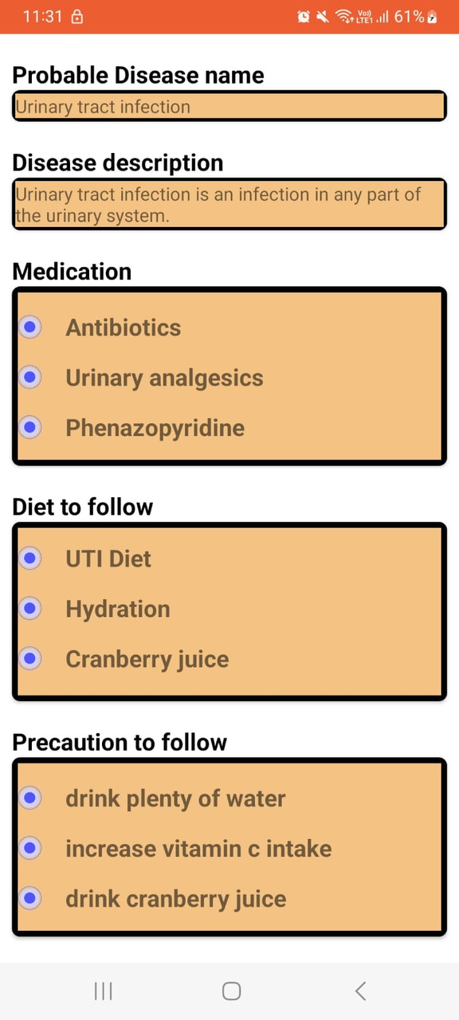

Slide 7
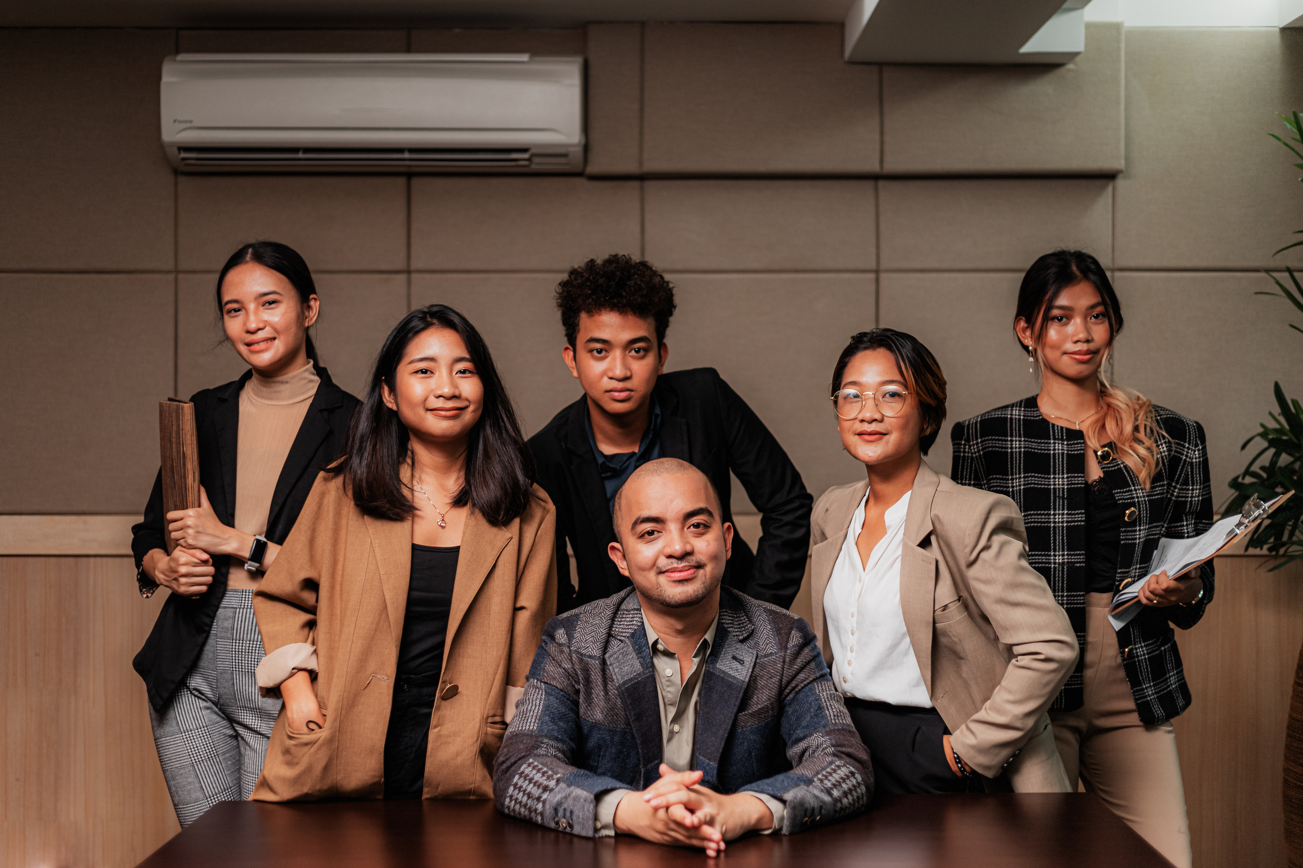
TECHNOLOGY STACK
MACHINE LEARNING
ANDROID APP DEVELOPMENT
LIBRARIES USED- Scikit-learn, numpy and pandas
Android sdk, Flask , Render
MODEL USED- Support vector classification

Slide 8
TEAM MEMBERS
AYUSHI GUPTA
AARAV YADAV
ANANT JAISWAL
KSHITIZ
JAIBEER YADAV
MOHD. AZEEM

Slide 9


THANK YOU!
+123-456-7890
123 Anywhere St., Any City
@reallygreatsite
hello@reallygreatsite.com

